Slide 1
Common Graphs

Slide 2
Common Graphs
Ways to chart categorical data
Bar graphs
Pie charts
Ways to chart quantitative data
Histograms
Boxplots
Time plots
Examining relationships between a pair of quantitative variables
Scatter plot

Slide 3
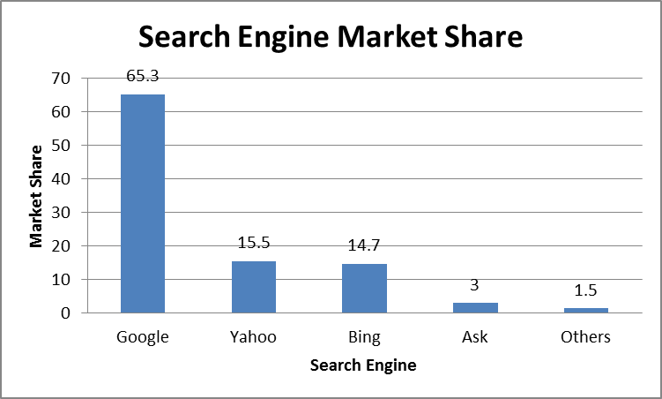
Ways to chart categorical data – Bar Graphs
Bar graphs: Each category is represented by a bar.

Slide 4
There are many different variants of bar graphs
Pareto chart (categories order from high to low)
Vertical bar graph
Stacked bar graphs

Slide 5
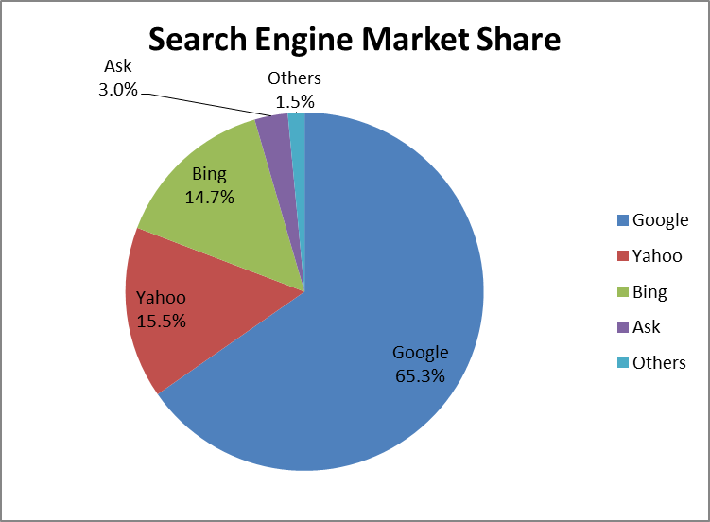
Ways to chart categorical data – Pie Chart
Pie charts: The slices must represent the parts of one whole.

Slide 6
Ways to Chart Quantitative Data - Histograms
Summary plot for a single variable
Shows center, variability, skewness, modality, outliers, or strange patterns.

Slide 7
Issues with Histograms
For small data sets, histograms can be misleading.
Small changes in the data, bins, or anchor can deceive
For large data sets, histograms can be quite effective at illustrating general properties of the distribution.
Histograms effectively only work with 1 variable at a time
But ‘small multiples’ can be effective
Bin width matters
Small bin width: show too much details and can be hard to read
Large bin width: can show misleading patterns

Slide 8
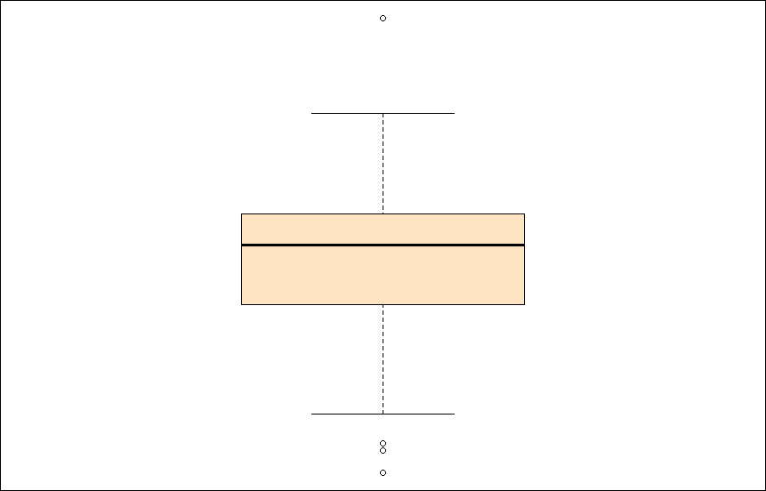
Boxplots Ways to Chart Quantitative Data – Box Plots
Summary plots showing five summary statistics of a single variable:
minimum
first quartile
second quartile (median)
third quartile
maximum
Negatives
Hard to tell distributional shape
no standard implementation in software

Slide 9
Two Variables – One Categorical
If one variable is categorical, use small multiples
Side by side boxplots are very effective in showing differences in a quantitative variable across factor levels

Slide 10
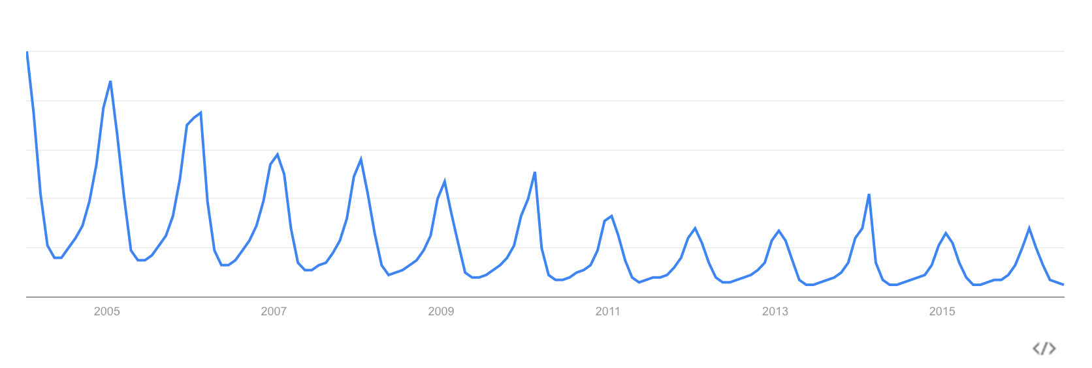
Google Trend - Skiing

Slide 11
Time Plots
Use when there is a meaningful sequence, like time.
In a time plot, time always goes on the horizontal axis.
We describe time series by looking for an overall pattern and for striking deviations from that pattern. In a time series:
A trend is a rise or fall that persists over time, despite small irregularities.
A pattern that repeats itself at regular intervals of time is called seasonal variation.

Slide 12
Source: Wikipedia, retrieved on June 15, 2016
Notes:
Graph from Wikipedia

Slide 13
Scatterplot
A scatterplot shows the relationship between two quantitative variables.
Typically, the explanatory or independent variable is plotted on the x axis, and the response or dependent variable is plotted on the y axis.
Each pair of data appears as a point in the plot.

Slide 14

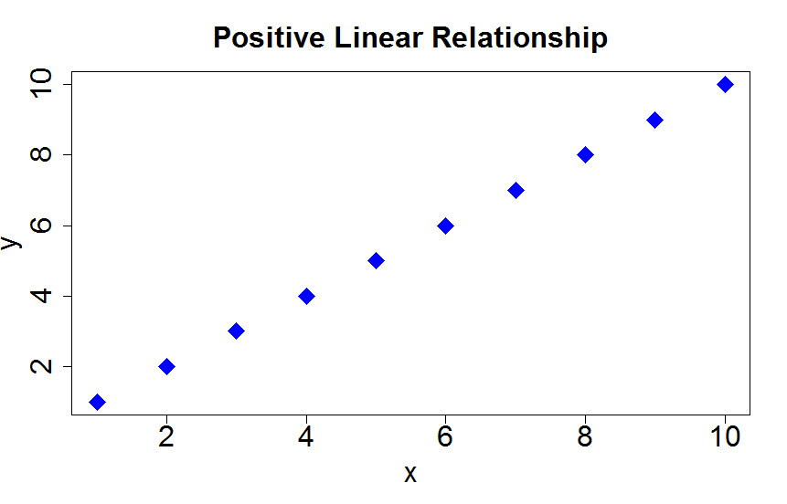
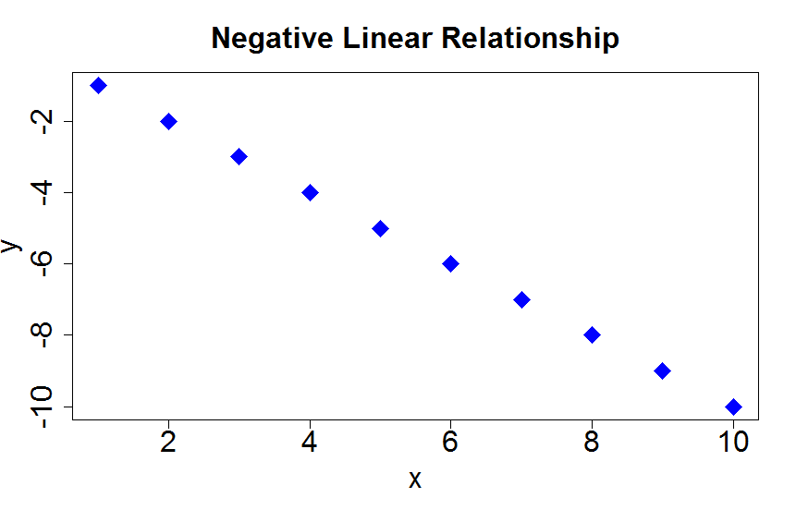
Positive association: High values of one variable tend to occur together with high values of the other variable.
Negative association: High values of one variable tend to occur together with low values of the other variable.

Slide 15
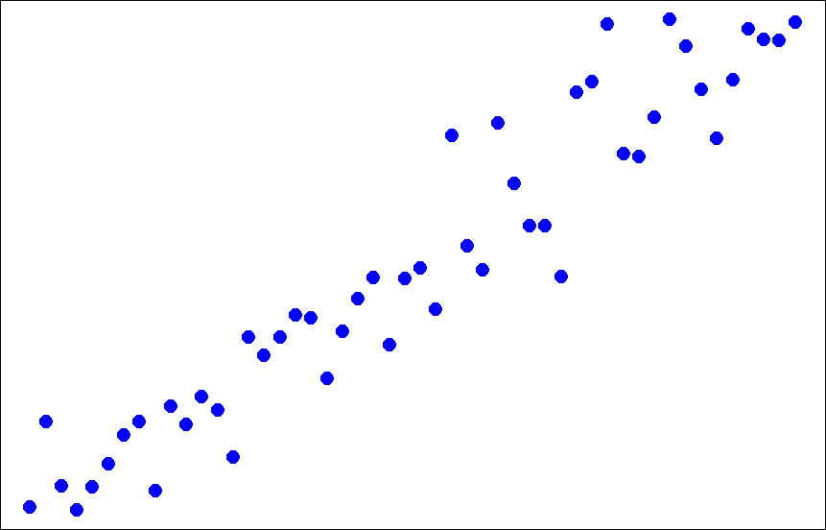
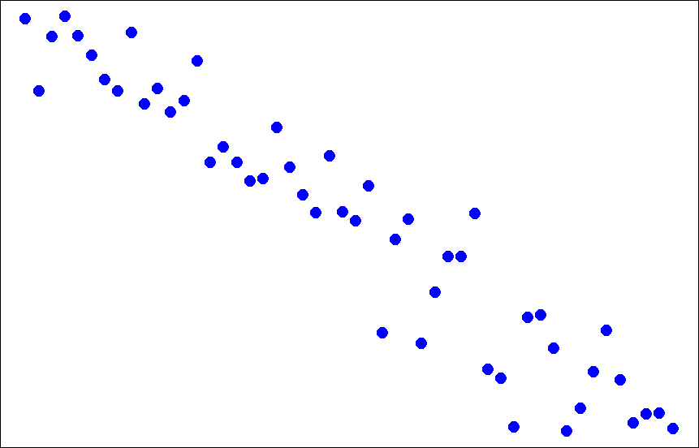
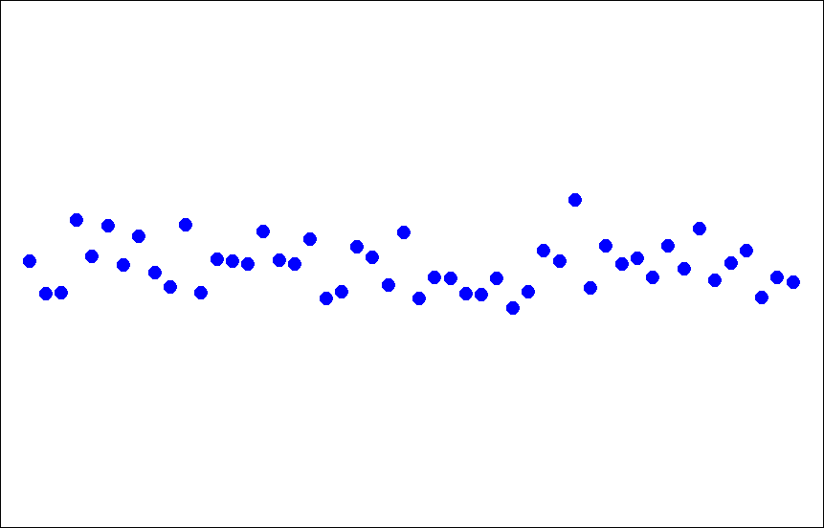
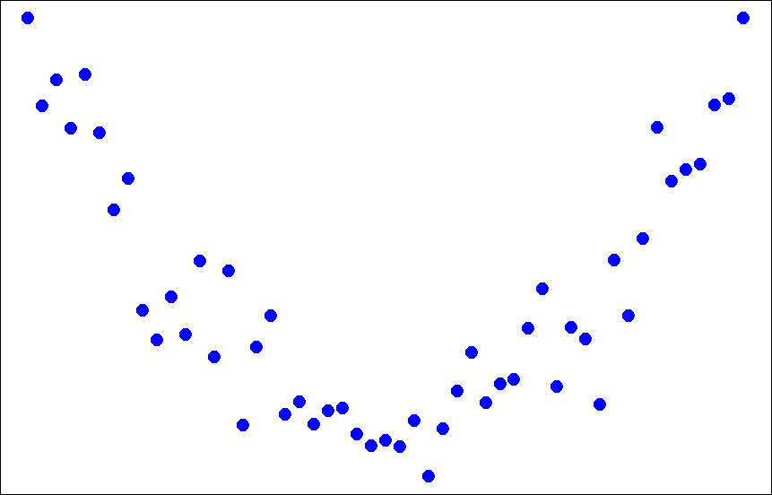
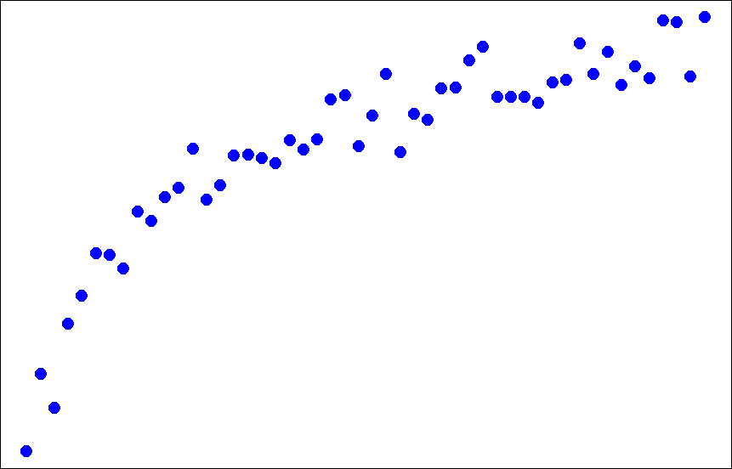
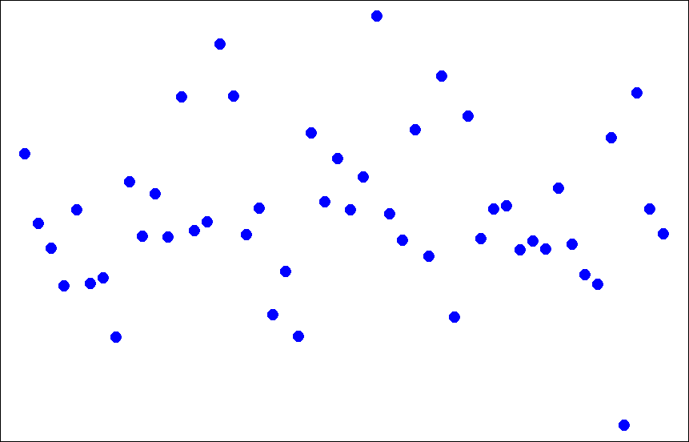
Form and Direction of an Association
Linear
No relationship
Nonlinear

Slide 16
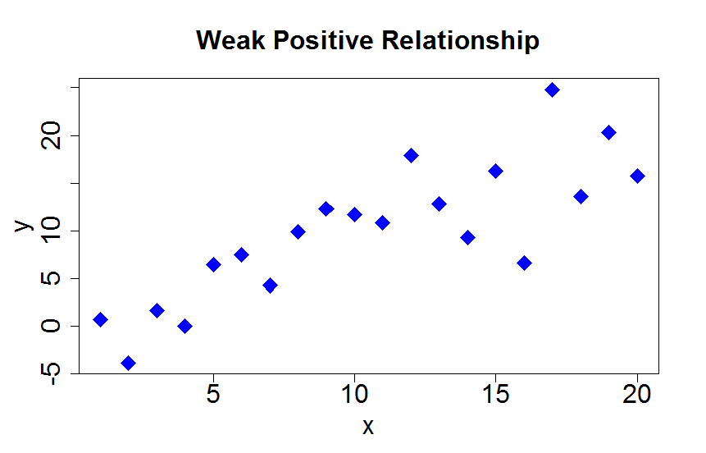
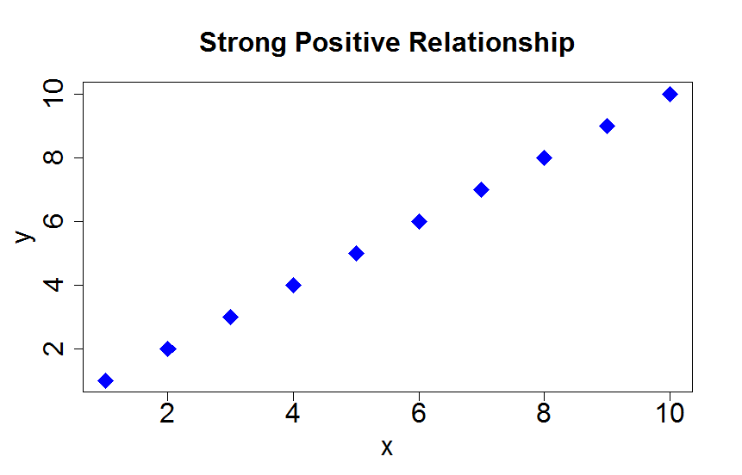
Strength of the Association
The strength of the relationship between the two variables can be seen by how much variation, or scatter, there is around the main form.
With a strong relationship, you can get a pretty good estimate of y if you know x.
With a weak relationship, for any x you might get a wide range of y values.

